Slide 1
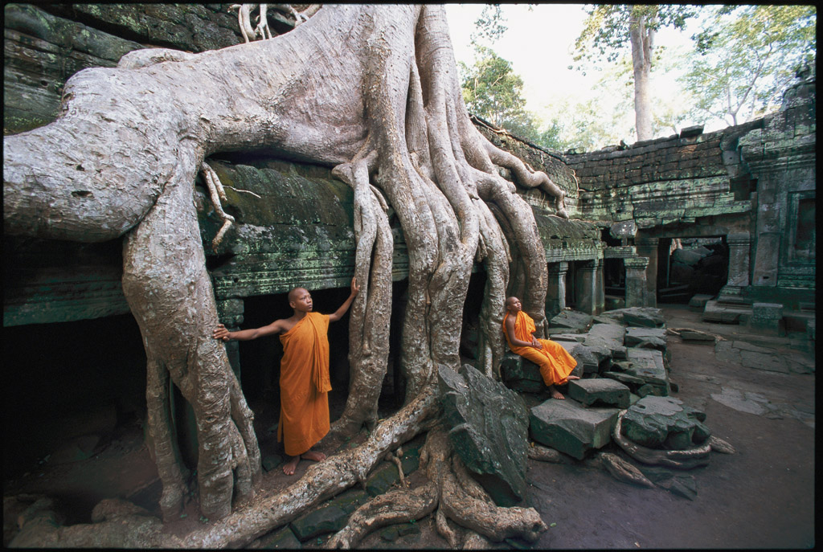
KEY CONCEPT Plants have specialized cells and tissue systems.

Slide 2
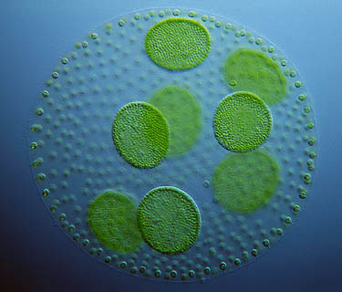
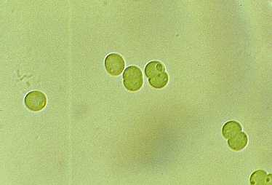
Plant life began in the water and became adapted to land.
Plants are multicellular eukaryotes that produce food through photosynthesis.
Ancient species of green algae is the common ancestor of all plants
Ancient Protists engulfed cyanobacteria
Cyanobacteria

Slide 3
Challenges and Plant adaptions to life on Land
Prevent water loss: Cuticle and Stomata
Growing Upright: Lignin
Transporting Resources: Vascular System
Reproduction on dry land: Pollen grain and Seeds

Slide 4
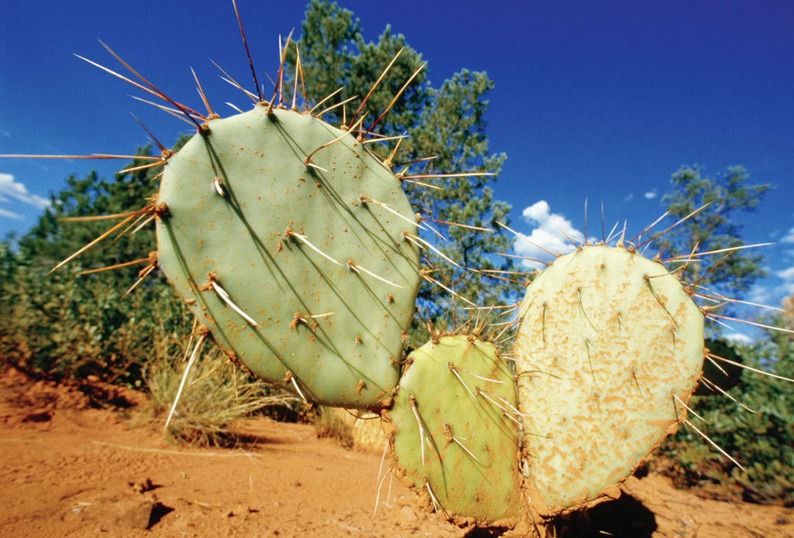
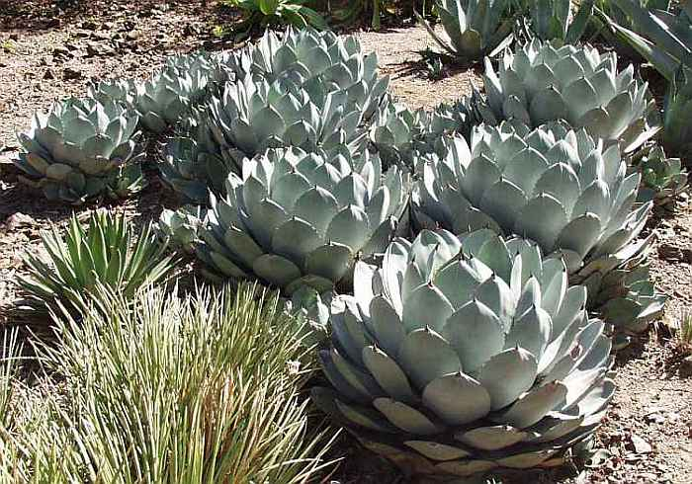
Leaves have many adaptations.
Hot dry environments:
Cacti leaves are sharp spines that protect them from predators and minimize water lost to transpiration
Water storage in leaves is protected by thick waxy cuticles.

Slide 5
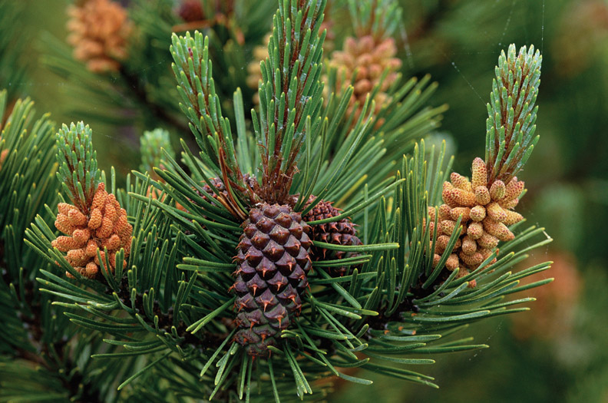
Leaves have many adaptations.
Cold dry environments, ex: pine needles
Small surface area, thick waxy epidermis help prevent damage due to cold temperatures
Tiny shrunken areas for stomata reduce water loss

Slide 6
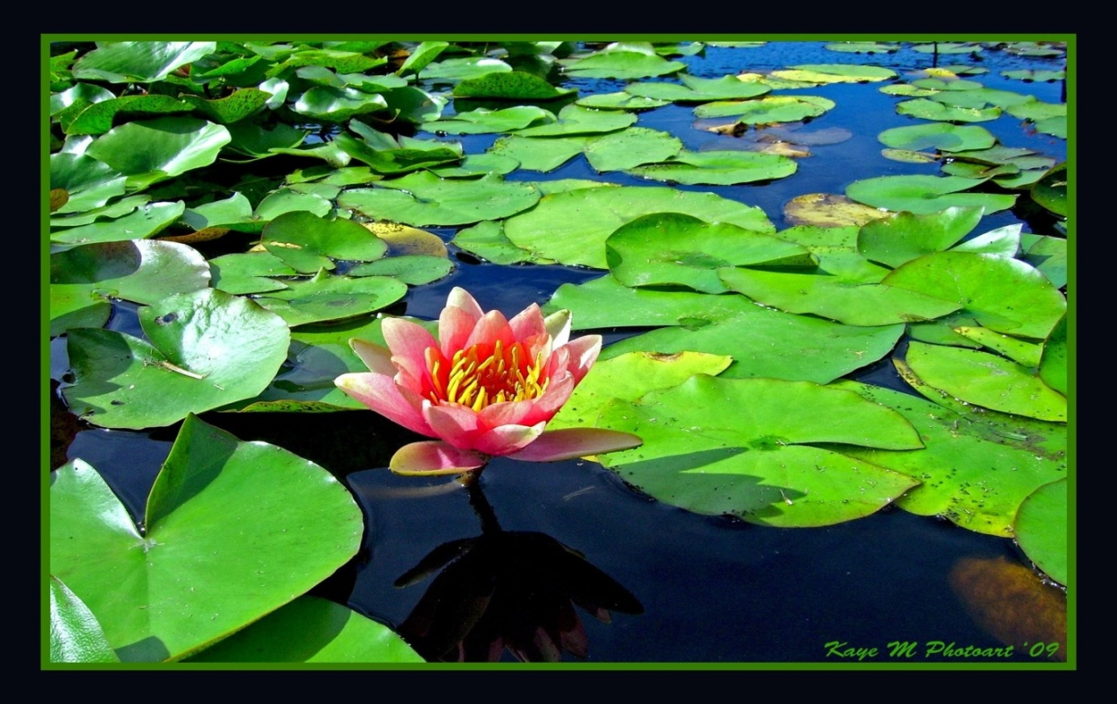
Water Lily leaves have stomata on the top surface of leaves for gas exchange flexible petioles allow plant to adapt to wave action.
Leaves have many adaptations.

Slide 7
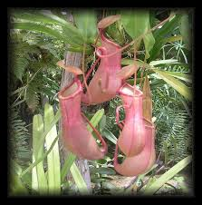
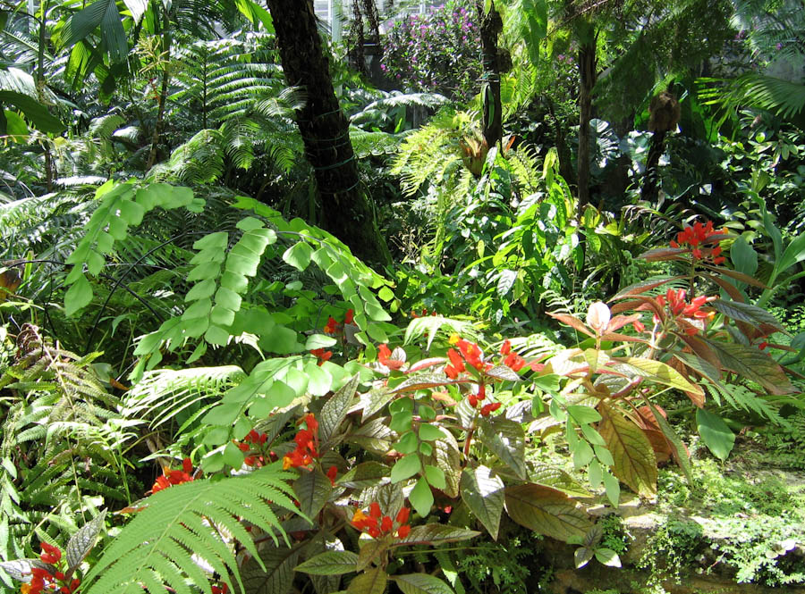
Adaptions of plants
Tropical plants have very large broad leaves to compete for light and space among other plants
Pitcher plant has leaves that enable it to lure, trap and digest insects which allows them to grow in soil that is low in Nitrogen.

Slide 8
To Review Leaves and their adaptions.
Go to classzone
Chapter 21: Sections 4
Cambridge Textbook pp 107-108

Slide 9
Classification of Plants:
Seedless non vascular plants: Mosses, liverworts and hornworts. Live close to ground where they can absorb water and nutrients. Water transports sperm to egg
Seedless vascular plants: club mosses, whisk ferns, horsetails and ferns. Can grow higher above the ground and transport water and nutrients. Still needs water to transport sperm to egg

Slide 10
Plant Types: Seed Plants: Can reproduce without free-standing water. Pollen is carried by wind or animals.
The largest phylum in the plant kingdom are flowering plants. Angiosperms: seed plants that reproduce with flowers and fruits.
Flowers attract animals to transport pollen to other plants
Fruits are eaten and the seeds then pass through the digestive tract
Wind-borne pollination or clinging burrs also may occur.
Gymnosperms: conifers. Seeds are not enclosed in a fruit. Modified leaves form cones and needle shaped leaves. They are adapted to dry environments. Rely on wind-borne pollination.

Slide 11
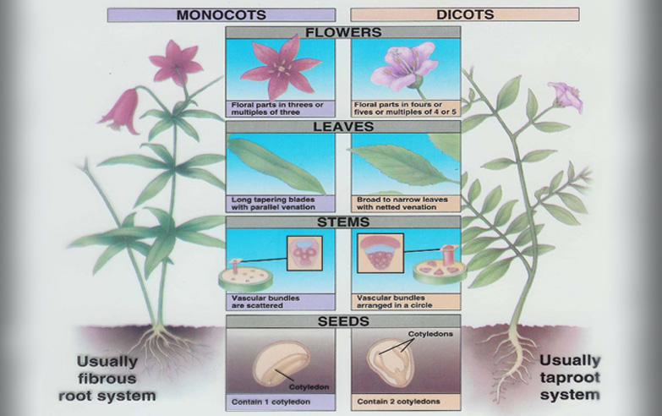
Angiosperms: Monocot vs Dicot

Slide 12
Three Lifespans of Flowering plants
Annuals live for only one year. It will germinate, flower produce seeds and then die..
Biennials have a two-year lifespan. The plant puts out leaves (but no flowers) in its first growing season. In the fall, the leaves either die back or, in some cases, persist throughout the winter. The plant’s energy is stored in the roots until spring, when leaves begin to grow again. In spring or summer, the plant puts up a stalk and produces flowers and then seeds. After seed are ready, it dies.
Perennials plant continues to live for several years. It flowers and sets seed each spring or summer, beginning with its second year, and goes dormant each winter, storing energy in its roots.

Slide 13
Plants in Human Culture
Farming: 10,000 years ago, we began cultivating plants and altered wild species through artificial selection.
Botany: the study of plants
Ethno botany: the study of how people in different cultures use plants
Pharmacology: the study of drugs and their effects on the body. Many drugs used today are derived from plants
Alkaloids: plant chemicals containing Nitrogen, some of which have anticancer properties.
Synthetic drugs: based on structures of natural plant compounds

Slide 14
To review origins of plant life, classifications and plants in the human culture.
Go to classzone
Chapter 20: Sections 1, 2, 3 and 4

Slide 15
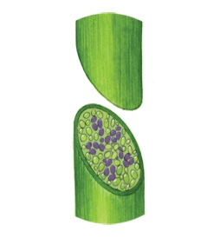
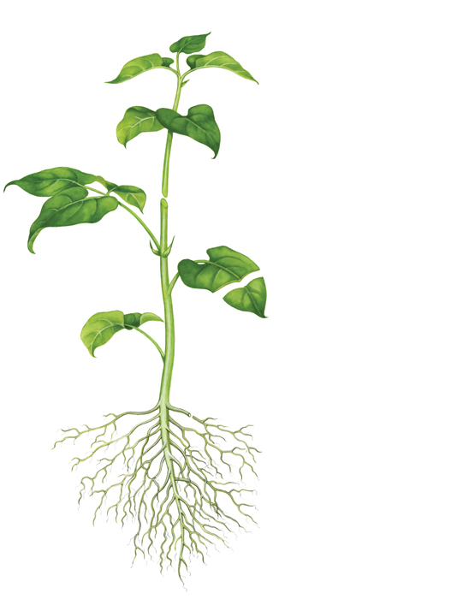
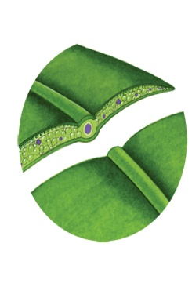
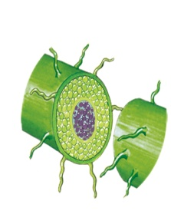
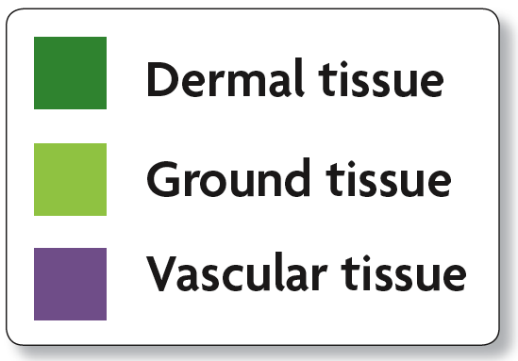
Plant organs are made of four tissue systems.
Meristematic tissue
Undifferentiated tissue where growth occurs
Eventually differentiates into dermal, ground or vascular tissue.
Dermal tissue covers the outside of a plant.
protects the plant
secretes cuticle of leaves
forms outer bark of trees
Vascular tissue
Hollow tubes for transport
xylem transports water and minerals
phloem transports photosynthetic products
Ground tissue is found inside a plant
provides support and storage
usually parenchyma cells
stem
leaf
root

Slide 16
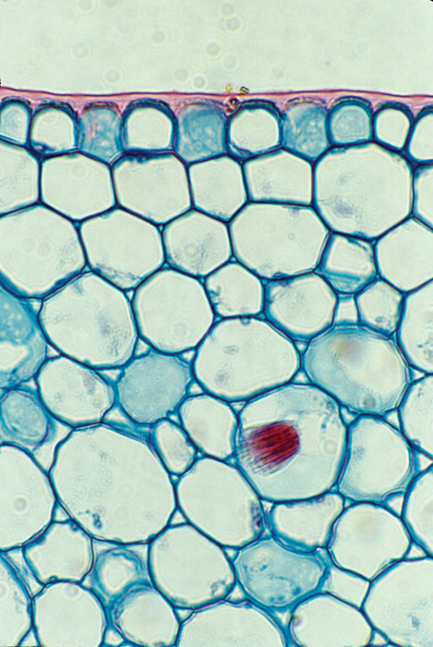
Ground Tissue is the most common type of plant tissue and differs according to their cell walls.
Parenchyma
Function: storage, photosynthesis, secretion
Most common
thin flexible walls

Slide 17
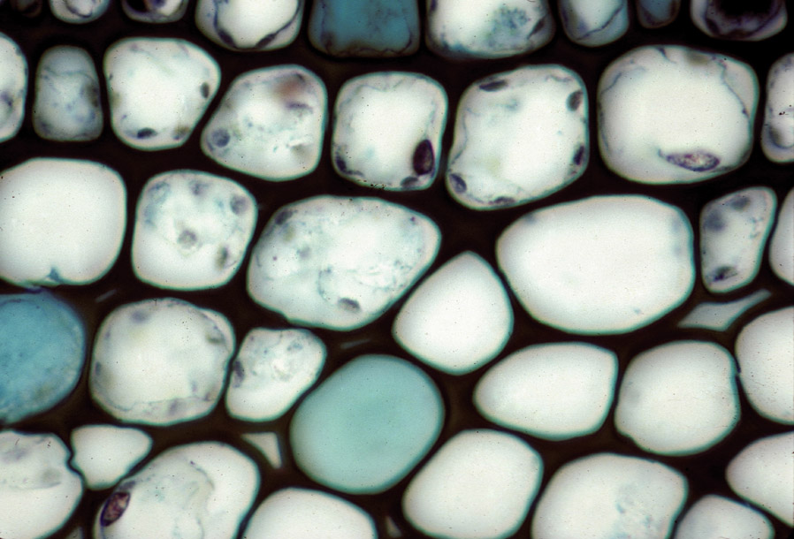
Collenchyma (kuh-LEHNG-kuh-muh) cells provide support to a growing plant.
they are strong and flexible.
celery strings are strands of collenchyma.
they have unevenly thick cell walls.

Slide 18
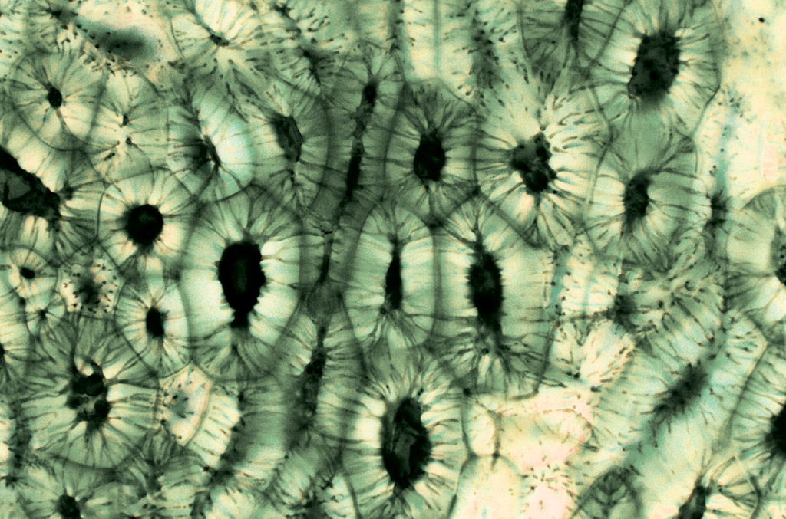
Sclerenchyma (skluh-REHNG-kuh-muh)cells are the strongest plant cell type.
second cell wall hardened by lignin (LIHG-nihn)
die when they reach maturity
used by humans to make linen and rope

Slide 19
To review origins of plant life, classifications and plants in the human culture.
Go to classzone
Chapter 21: Sections 1

Slide 20
The Vascular system allows for the transport of water, minerals and sugars.
Movement of water and minerals through the Xylem
Movement of Sugar through the Phloem

Slide 21
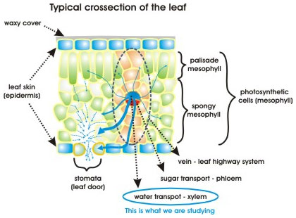
The Vascular system allows for the transport of water, minerals and sugars. Vascular Bundles contain xylem and phloem
Xylem
Larger & thicker
Carries water
Phloem
Smaller and thinner
Carries sucrose and other substances the leaf has made

Slide 22
Plants don’t use energy to move water through the xylem.
Cohesion-tension theory:
The physical properties of water allow for capillary action
Hydrogen bonding: cohesion between water molecules and adhesion between the water molecules and the xylem walls
Cohesion and adhesion create tension keeps the water column together inside the plant
Transpiration: is the main force moving water
As water vapor evaporates from the leaves, the water pressure in the xylem is lowered creating a vacuum that pulls the water upward.

Slide 23
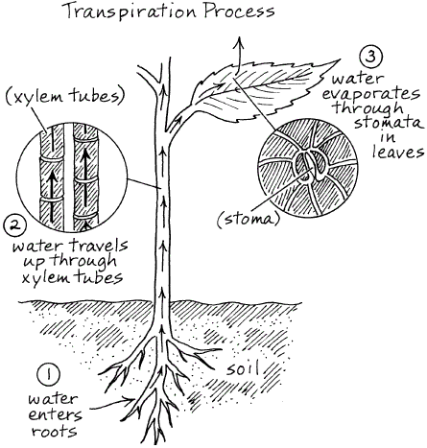
Transpiration

Slide 24
Xylem Vessel also helps to support plants
Made of many hollow dead cells, joined end to end
Thick cell walls containing lignin
End walls have dissolved
Contains no cytoplasm of nuclei
Run from the roots of the plant through the stem and into every leaf.

Slide 25
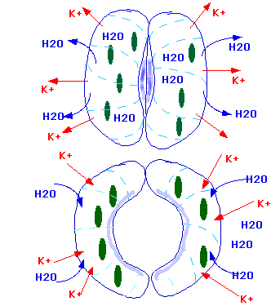
Stoma
Potassium ion concentration
controls the opening and
Closing of the stomata
When would the stoma close?
When would the stoma open?

Slide 26
Phloem Carries the products of photosynthesis toward in any needed direction.
Moves from the sugar source (high concentration of sugar) to sugar sink (any part of the plant which will be using sugar)
The Sources and sinks in a plant change as a plant grows and as the seasons change.

Slide 27
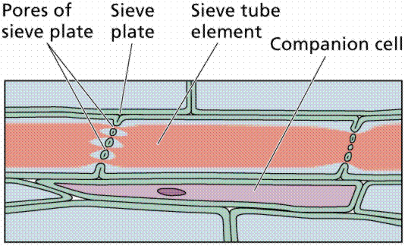
Structure of Phloem

Slide 28
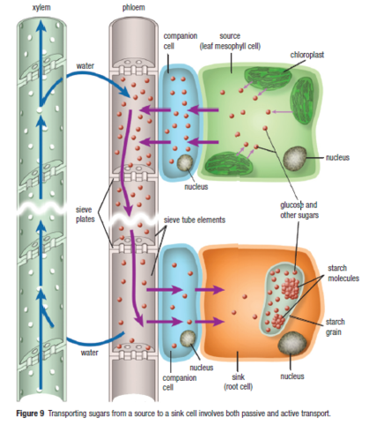
Xylem and Phloem

Slide 29
Review Material
Cambridge Textbook pp 100-111

