Slide 1
DNA Replication Objectives
Summarize the process of DNA replication
Identify the role of enzymes in the replication of DNA
Describe how complementary base pairing guides DNA replication
Describe how errors are corrected during DNA replication

Slide 2
DNA Replication Vocabulary
DNA replication
helicase
replication fork
DNA polymerase
Semi-conservative replication
mutation

Slide 3
DNA Replication
What is it?
  The process by which DNA is copied during the cell cycle (what phase?)
  Why do we need to copy the DNA?
  When is DNA duplicated?

Slide 4
DNA Replication
What controls and carries out the process of replication?
  Enzymes! (What are they?)
  Some unzip the double helix (Helicase) and others hold the strands apart while the strands serve as templates for replication
  DNA polymerase: enzyme that adds and bonds together nucleotides that correspond to the template strand to form the new strand of DNA

Slide 5
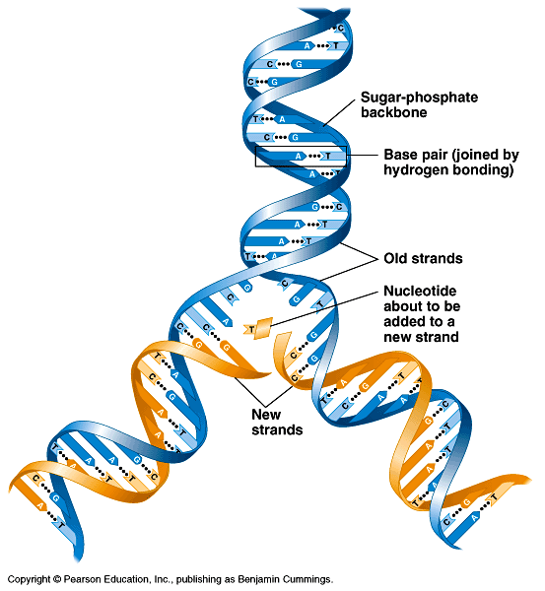
How is DNA copied?
Base pairing suggests that it will allow each side to serve as a template for a new strand

Slide 6
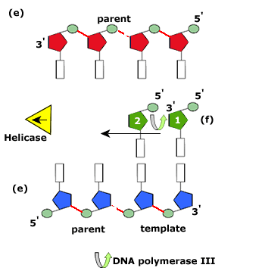
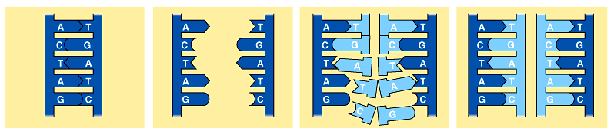
DNA Replication
Occurs in the 5’→3’
direction

Slide 7
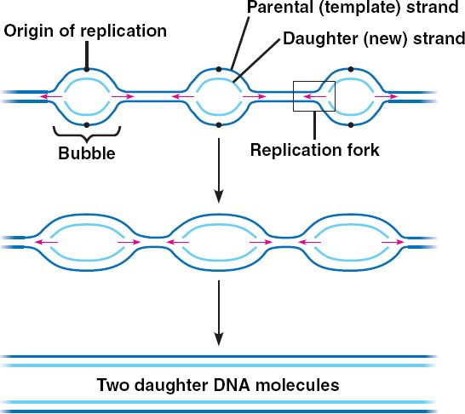
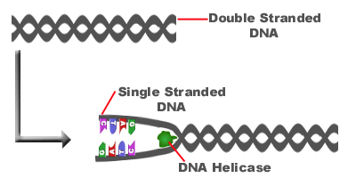
3 Steps of Replication
Step 1:
  Helicase unzips double helix at numerous places along the chromosome (origins of replication)
    By breaking hydrogen bonds connecting base pairs

Slide 8
3 Steps of Replication
Step 2
  Free-floating nucleotides pair, one by one, with bases on the template
  DNA polymerases bond the nucleotides together to form new strands that are complementary to each template strand

Slide 9
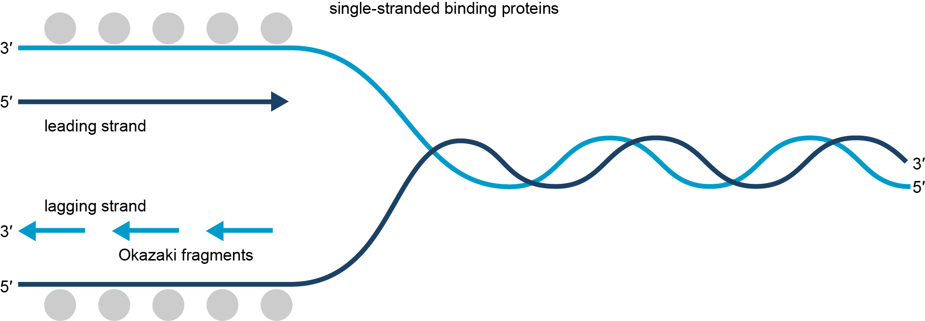
DNA replication occurs in a smooth, continuous way on the leading strand.
The lagging strand is assembled in short pieces called Okazaki fragments. The pieces are joined together by ligase.

Slide 10
3 Steps of DNA Replication
Step 3
  Two identical molecules of DNA result
  Each new molecule has one strand from the original molecule and one new strand
    As a result, DNA replication is called semiconservative because one old strand is conserved, and one complementary new strand is made.

Slide 11
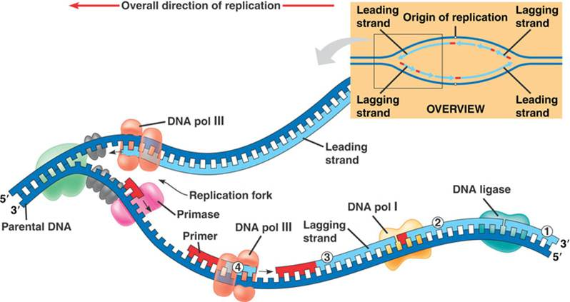

Slide 12
Quick Lab: Modeling DNA Replication
Using two zipping plastic bags to model how complementary strands of DNA attach during replication
Materials: two zipping bags, scissors
Procedure:
1. cut the sliding zippers off both bags.
  One zipper represents the template strands of a DNA molecule
2. Cut one of the zippers into four smaller pieces and unzip each of them. These represent free nucleotides. Don’t worry about which nucleotide is which in this activity
3. Use the pieces to model replication to a classmate

Slide 13
DNA Replication Concept Review
Describe what happens at a DNA replication fork during replication
Describe the role of helicases and DNA polymerases during DNA replication
State why DNA replication is a semi conservative process.
Compare the number of replication forks in a prokaryotic and eukaryotic DNA during replication
How are replication errors corrected?
Why are there two DNA polymerases at one replication fork?
Why are DNA repair enzymes important to an organisms survival?
Is a mutation that occurs during the formation of an egg cell or sperm cell more significant than a mutation that occurs in a body cell? Explain.

Slide 14
Protein Synthesis Objectives
Outline the flow of genetic information in cells from DNA to protein
Compare the structure of RNA with that of DNA
Summarize the process of transcription
Describe the importance of the genetic code
Compare the role of mRNA, rRNA and tRNA in translation
Identify the importance of learning about the human genome

Slide 15
Protein Synthesis Vocabulary
Ribonucleic acid RNA transcription
Translation protein synthesis
Ribose mRNA (messenger)
rRNA (ribosomal) tRNA (transfer)
RNA polymerase promoter
Termination signal genetic code
Codon anticodon
genome

Slide 16
Transcription
Objectives:
Explain the Central Dogma
Describe how Transcription converts a gene into a single-stranded RNA molecule.
Identify the three main types of RNA and their functions.
Vocabulary:
Central dogma messenger RNA RNA
Transcription RNA polymerase ribosomal RNA
Transfer RNA

Slide 17
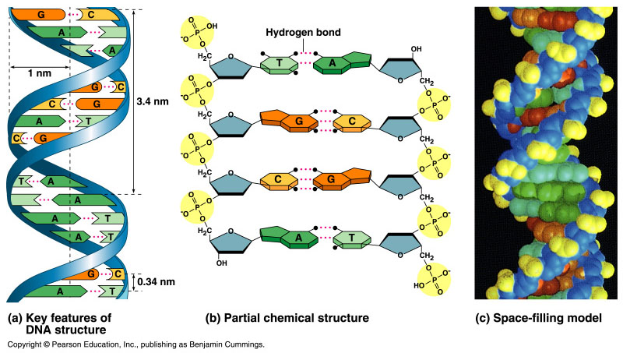
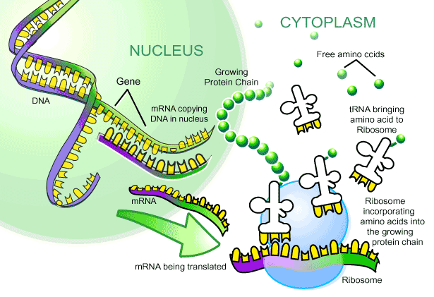
From Gene to Protein

Slide 18
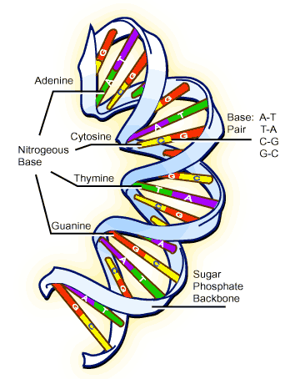
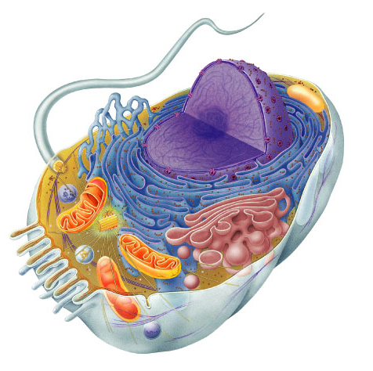
Bodies → Cells → DNA
Bodies are made up of cells
All cells run on a set of instructions spelled out in DNA

Slide 19
Structure of DNA: Paired bases
Bases match together
  A pairs with T
    A : T
  C pairs with G
    C : G
  weak bonds between bases join 2 strands
    can separate easily

Slide 20
DNA → Cells → Bodies
How does DNA code for cells & bodies?
  how are cells and bodies made from the instructions in DNA

Slide 21
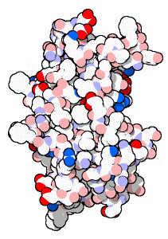
DNA → Proteins → Cells → Bodies
DNA has the information to build proteins
proteins
cells
DNA gets all the glory,
Proteins do all the work
bodies

Slide 22
What do we know?
DNA
  DNA is the genetic information
Proteins
  proteins run living organisms
  enzymes
    all chemical reactions in living organisms are controlled by enzymes (proteins)
  structure
    all living organisms are built out of proteins
DNA is the instructions for making proteins

Slide 23
What do we know?
DNA
  DNA is in the nucleus
  want to keep it there = protected
    “locked in the vault”
Proteins
  made by a “protein factory” in cytoplasm
  ribosomes
Need to get gene (DNA) information from nucleus to cytoplasm
  need a messenger!
  need a copy of DNA
  mRNA
nucleus

Slide 24
Who is the messenger?
  messenger RNA (mRNA)
DNA
build proteins
RNA
mRNA
nucleus
cytoplasm

Slide 25
From nucleus to cytoplasm
Central Dogma: information flows in one way: From DNA to RNA to proteins.
transcription
DNA
mRNA
protein
translation
trait
nucleus
cytoplasm

Slide 26
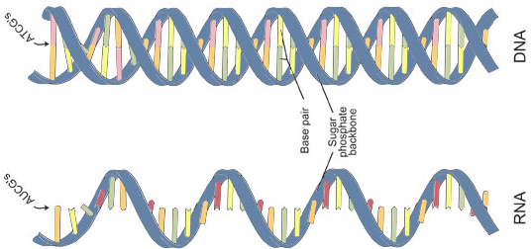
DNA vs. RNA
DNA
http://www.actstudent.org/regist/add-photo.html sugar
nitrogen bases
  G, C, A, T
    T = thymine
  T : A
  C : G
double stranded
RNA
ribose sugar
nitrogen bases
  G, C, A, U
    U = uracil
  U : A
  C : G
single stranded

Slide 27
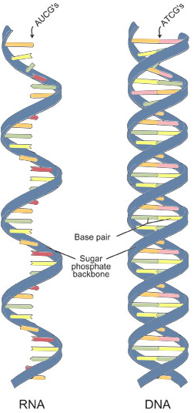
DNA vs. RNA
DNA
RNA
DNA

Slide 28
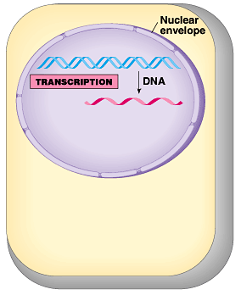
Transcription
Making mRNA from DNA
DNA strand is the
template (pattern)
  match bases
    U : A
    G : C
Enzyme
  RNA polymerase: bonds nucleotides together to make RNA

Slide 29
Matching bases of DNA & RNA
Double stranded DNA unzips
T
G
G
T
A
C
A
G
C
T
A
G
T
C
A
T
C
G
T
A
C
C
G
T

Slide 30
Matching bases of DNA & RNA
Double stranded DNA unzips
T
G
G
T
A
C
A
G
C
T
A
G
T
C
A
T
C
G
T
A
C
C
G
T

Slide 31
Matching bases of DNA & RNA
A
Match RNA bases to DNA bases on one of the DNA strands
C
G
U
G
A
U
G
U
C
U
C
G
A
A
C
U
A
G
A
C
U
A
RNA
polymerase
G
A
C
C
T
G
G
T
A
C
A
G
C
T
A
G
T
C
A
T
C
G
T
A
C
C
G
T

Slide 32
Matching bases of DNA & RNA
U instead of T is matched to A
As the transcription complex moves forward, the DNA strand rezips.
DNA
TACGCACATTTACGTACGCGG
mRNA
AUGCGUGUAAAUGCAUGCGCC

Slide 33
Modeling Transcription Activity
During transcription a strand of mRNA that complements the base sequence on a strand of DNA is made.
Make a model to demonstrate how the process occurs.

Slide 34
Transcription makes three main types of RNA
Messenger RNA (mRNA) the intermediate message between DNA and proteins. This is the strand which will be translated to form a protein
Ribosomal RNA (rRNA) forms a significant part of ribosomes
Transfer RNA (tRNA) carries amino acids from the cytoplasm to the ribosome during translation.

Slide 35
What do we know?
nucleus
DNA
  instructions remain in nucleus
mRNA
  has the instructions for building proteins from DNA
Proteins
  built as chains of amino acids
What reads RNA?
  need a mRNA reader!
  ribosome
A
C
C
A
U
G
U
C
G
A
U
C
A
G
U
A
G
C
A
U
G
G
C
A
aa
aa
aa
aa
aa
aa
aa

Slide 36
From gene to protein
cytoplasm
aa
aa
transcription
translation
aa
protein
DNA
mRNA
aa
aa
aa
aa
ribosome
mRNA leaves nucleus through nuclear pores
A
C
C
A
U
G
U
C
G
A
U
C
A
G
U
A
G
C
A
U
G
G
C
A
proteins synthesized by ribosomes using instructions on mRNA
trait
nucleus

Slide 37
What do we know?
aa
mRNA
  has the instructions for building proteins
  from DNA
Proteins
  built as chains of amino acids
What reads mRNA?
  ribosome
What brings the right amino acid to attach to the protein chain?
  need an amino acid transporter!
A
C
C
A
U
G
U
C
G
A
U
C
A
G
U
A
G
C
A
U
G
G
C
A
aa
aa
aa
aa
aa
ribosome
aa

Slide 38
From gene to protein
Who is the transporter?
tRNA transports amino acids
aa
aa
transcription
translation
aa
protein
DNA
mRNA
aa
aa
aa
aa
ribosome
A
C
C
A
U
G
U
C
G
A
U
tRNA
C
A
G
U
A
G
C
A
U
G
G
C
A
aa
trait
nucleus
cytoplasm

Slide 39
RNA to protein
mRNA leaves nucleus
mRNA goes to ribosomes in cytoplasm
Proteins built from instructions on mRNA
How?
mRNA
A
C
C
A
U
G
U
C
G
A
U
C
A
G
U
A
G
C
A
U
G
G
C
A
aa
aa
aa
aa
aa
aa
aa
aa

Slide 40
Translation
Concepts:
Amino acids are coded by mRNA base sequences
Codon is a three nucleotide sequence that codes for an amino acid
Amino acids are linked to become a protein

Slide 41
Translation
Vocabulary:
Translation
Codon
Stop codon
Start codon
anticodon

Slide 42
How does mRNA code for proteins?
DNA
TACGCACATTTACGTACGCGG
mRNA
AUGCGUGUAAAUGCAUGCGCC
?
protein
Met Arg Val Asn Ala Cys Ala
How can you code for 20 amino acids with only 4 nucleotide bases (A,U,G,C)?

Slide 43
mRNA codes for proteins in triplets
DNA
TACGCACATTTACGTACGCGG
codons
AUGCGUGUAAAUGCAUGCGCC
mRNA
AUGCGUGUAAAUGCAUGCGCC
mRNA
ribosome
?
ribosome
protein
Met Arg Val Asn Ala Cys Ala
Codon
  block of 3 nucleotides

Slide 44
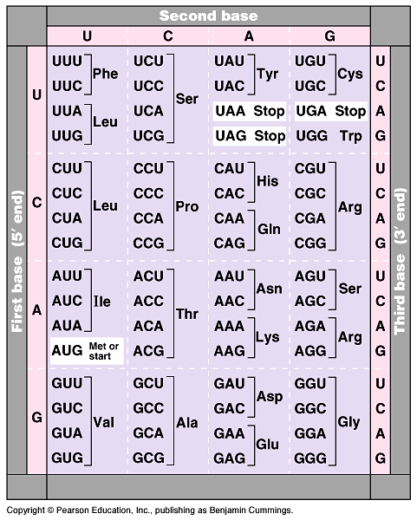
The mRNA code
Common language For ALL life and viruses
  strongest support for a common origin for all life:
  can put a gene from one species into another.
Code is redundant
  several codons for each amino acid
  mutation insurance!
Notes:
Strong evidence for a single origin in evolutionary theory.

Slide 45
Triplet Code: must be read in the correct order
Codon: three nucleotide sequence that codes for an amino acid
  Example UUU and UUC code for the amino acid phenylalanine
  UUA and UUG code for amino acid leucine
Start codon signals the beginning of the amino acid
  AUG
  Amino acid: methionine (0ften removed later)
Stop codons: signal the end of the amino acid
  UGA, UAA, UAG
Anticodon: set of three nucleotides which is complementary to the mRNA codon
  Example anticodon CCC pairs the mRNA codon GGG

Slide 46
How are the codons matched to amino acids?
DNA
TACGCACATTTACGTACGCGG
mRNA
AUGCGUGUAAAUGCAUGCGCC
codon
tRNA
UAC
GCA
amino
acid
Met
anti-codon: set of 3 nucleotides that are complementary to an mRNA
CAU
Arg
Val

Slide 47
mRNA to protein = Translation
The reader →ribosome
The transporter → transfer RNA (tRNA)
ribosome
mRNA
A
C
C
A
U
G
U
C
G
A
U
C
A
G
U
A
G
C
A
U
G
G
C
A
U
G
G
U
A
C
aa
tRNA
A
G
C
aa
tRNA
U
A
G
aa
aa
tRNA
aa
tRNA
aa

Slide 48
From gene to protein
aa
aa
transcription
translation
aa
protein
DNA
mRNA
aa
aa
aa
aa
ribosome
A
C
C
A
U
G
U
C
G
A
U
tRNA
C
A
G
U
A
G
C
A
U
G
G
C
A
aa
trait
nucleus
cytoplasm

Slide 49
cytoplasm
transcription
translation
protein
nucleus
trait

Slide 50
From gene to protein

Slide 51
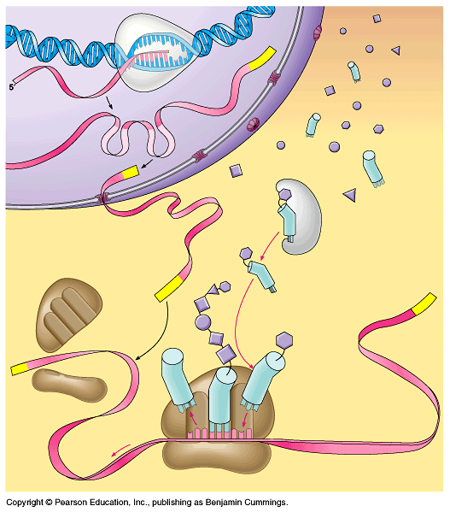
DNA
transcription
amino
acids
mRNA
Can you tell the story?
protein
ribosome
tRNA
translation

Slide 52
Any Questions??

Slide 53
From gene to protein
Who is the transporter?
tRNA transports amino acids
aa
aa
aa
transcription
translation
DNA
mRNA
aa
protein
aa
aa
aa
ribosome
A
C
C
A
U
G
U
C
G
A
U
tRNA
C
A
G
U
A
G
C
A
U
G
G
C
A
aa
nucleus
cytoplasm

Slide 54
From gene to protein
aa
aa
aa
transcription
translation
DNA
mRNA
aa
protein
aa
aa
aa
ribosome
A
C
C
A
U
G
U
C
G
A
U
tRNA
C
A
G
U
A
G
C
A
U
G
G
C
A
aa
nucleus
cytoplasm

Slide 55
Protein Synthesis Concept Review
Summarize the flow of genetic information.
List the four ways in which the structure of RNA differs from that of DNA
Sequence the main steps of transcription
What is the genetic code?
Compare the roles of the three different types of RNA during translation
Discuss why it is important which of the two DNA strands serves as a template during translation.
How does the structure of tRNA relate to its function in translation?

