Slide 1
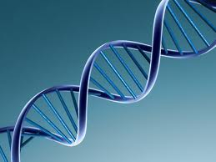
DNA, RNA and Protein Synthesis
Discovery of DNA
DNA Structure
DNA Replication
Protein Synthesis

Slide 2
Discovery of DNA
Relate how Griffith’s bacterial experiments showed that a hereditary factor was involved in transformation.
Summarize how Avery’s experiment led his group to conclude that DNA is responsible for transformation in bacteria.
Describe how Hershey and Chase’s experiment led to the conclusion that DNA, not protein, is the hereditary molecule in viruses.
Vocabulary: virulent, transformation, bacteriophage

Slide 3
Transformation: the passage of genetic material from one cell to another
Griffith’s experiments 1928
Studied different strains of bacteria S. pneumoniae
Some strains cause pneumonia in mammals others do not.
S strain: can cause pneumonia
R strain: does not cause pneumonia
He wanted to know if the strains contained a hereditary factor that could be passed from one strain to another.
Griffith concluded that a hereditary trait could be passed from Type S to type R transforming it into a strain which can cause pnemonia

Slide 4
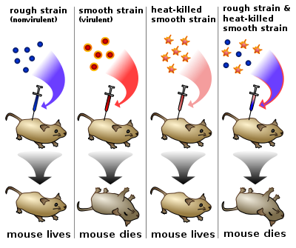
Griffith’s transformation experiment

Slide 5
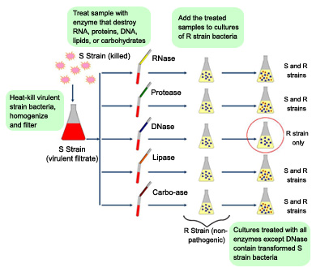
Avery’s experiments 1944
What is the transforming agent in Griffith’s experiments?
The polysaccharide coat, protein, RNA or DNA?
Answer DNA!

Slide 6
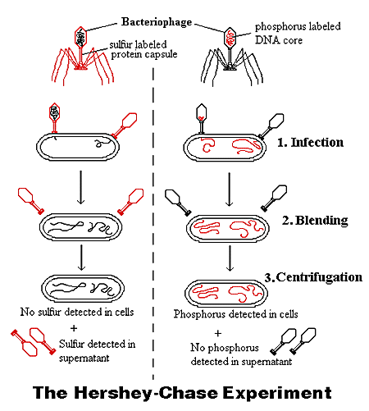
Hershey – Chase experiment 1952
Is DNA or Protein responsible for the hereditary information viruses transfer when they infect a bacterium?
2 trials:
Labeled protein with radioactive sulfur
labeled DNA with radioactive phosphorus
Results: the radioactive phosphorus was found in infected cells, not sulfur.
Conclusion: DNA must be the infecting agent.
Bacteriophage: a virus which infects bacteria

Slide 7
Concept Check
How did Griffith’s experiments show that a hereditary factor was involved in bacterial transformation?
Describe how the contributions of Avery and his colleagues revealed that DNA is responsible for transformation in bacteria.
How did Hershey and Chase experiment produce evidence that DNA not protein, is the hereditary material in viruses?
Why did heat kill Griffith’s bacteria?
What were the essential differences between the methods and results of Griffith and Avery’s experiments?

Slide 8
DNA STRUCTURE
Evaluate the contributions of Franklin helping Watson and Crick discover DNA’s double helix structure.
Describe the three parts of a nucleotide
Summarize the role of covalent and hydrogen bonds in the structure of DNA.
Relate the role of base pairing rules to the structure of DNA.

Slide 9
Vocabulary
Nucleotide deoxyribose nitrogenous base
Purine pyrimidine base-pairing rules
Complementary base pair
Base sequence

Slide 10
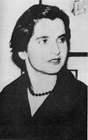
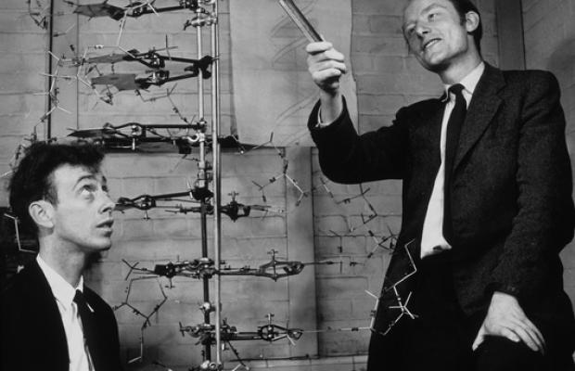
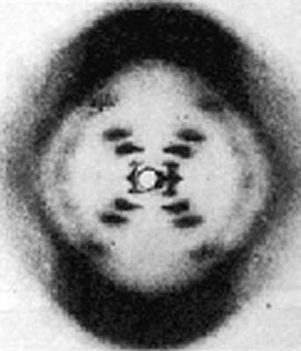
Rosaline Franklin 1950’s Watson and Crick 1953

Slide 11
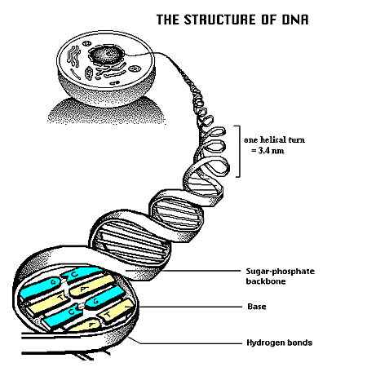
Structure of DNA
DNA is a nucleic acid made of two long chains (strands)
The structure is illustrated by a right handed double helix

Slide 12
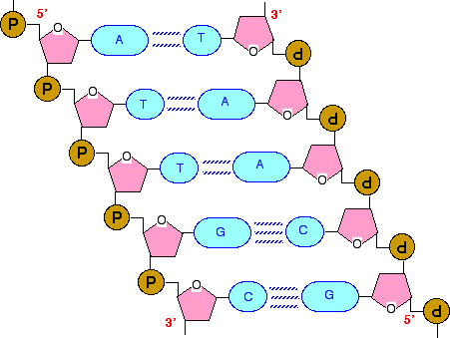
Structure of DNA
Strands are made of repeating units called nucleotides
The sides of the ladder are made of a sugar-phosphate backbone
The rungs are bases which are connected to the other side of the ladder by hydrogen bonds.

Slide 13
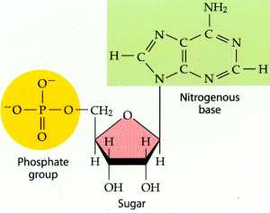
Nucleotide
Nucleotides have 3 parts
Five carbon sugar
deoxyribose
Phosphate group
Phosphorous (P) bonded to 4 oxygen (O) atoms
Nitrogenous base
A, T, G, C
Covalent bonds connect one nucleotide to the next.
The sugar connects to the following nucleotide’s phosphate

Slide 14
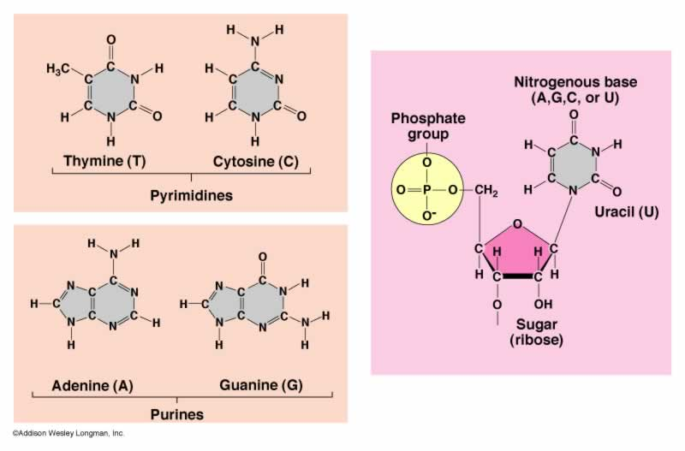
Nitrogenous Complementary Bases
Purines have two carbon rings
Pyrimidines have one carbon ring
Nucleotide

Slide 15
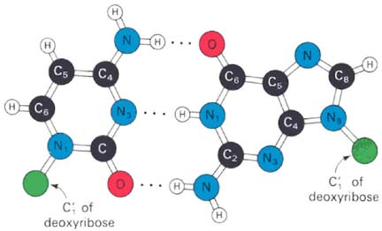
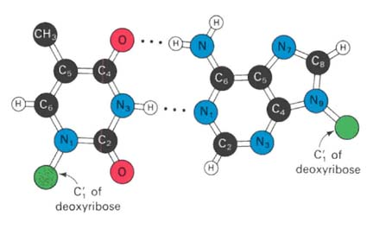
Hydrogen Bonding holds the Nitrogenous bases together
Cytosine (C) H bonds with Guanine (G)
Thymine (T) H bonds with Adenine (A)

Slide 16
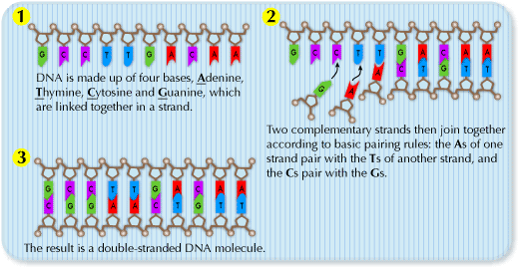
Base Pairing rules Cytosine (C) bonds with Guanine (G) Adenine (A) bonds with Thymine (T)
Hydrogen bonds hold them together Because the bases are complementary, the Strands are also complementary to each other

Slide 17
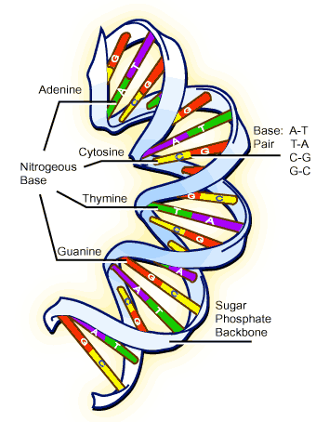
DNA Model
DNA model is often simplified.
Sugar phosphate backbone is shown as a solid line.
This allows the base pairs to be more easily seen
They may be further simplified into just the bases….
ACCTGTGAGAC
TGGACACTCTG

Slide 18
Concept Review
What piece of information did Franklin have that helped Watson and Crick determine the double helix structure of DNA?
Name the three parts of a nucleotide
Summarize the locations of covalent bonds and hydrogen bonds in a DNA molecule
Describe why the two strands of the complementary helix are considered to be complimentary.
State the base pairing rules in DNA
How do these base-pairing rules relate to the structure of DNA?
If 2.2 picograms of DNA could be extracted from a certain number of human muscle cells, about hos many picograms of DNA could be extracted from the same number of human gamete cells?
Use the base-pairing rules to determine the base sequence that is complementary to the sequence CGATTG
A plants DNA has nucleotides that are 20% thymine. What percent of guanine would be present?

Slide 19
DNA Replication Objectives
Summarize the process of DNA replication
Identify the role of enzymes in the replication of DNA
Describe how complementary base pairing guides DNA replication
Describe how errors are corrected during DNA replication

Slide 20
DNA Replication Vocabulary
DNA replication
helicase
replication fork
DNA polymerase
Semi-conservative replication
mutation

Slide 21
DNA Replication
What is it?
The process by which DNA is copied during the cell cycle (what phase?)

Slide 22
DNA Replication
What controls and carries out the process of replication?
Enzymes! (What are they?)
Some unzip the double helix (Helicase) and others hold the strands apart while the strands serve as templates for replication
DNA polymerase: enzyme that adds and bonds together nucleotides that correspond to the template strand to form the new strand of DNA

Slide 23
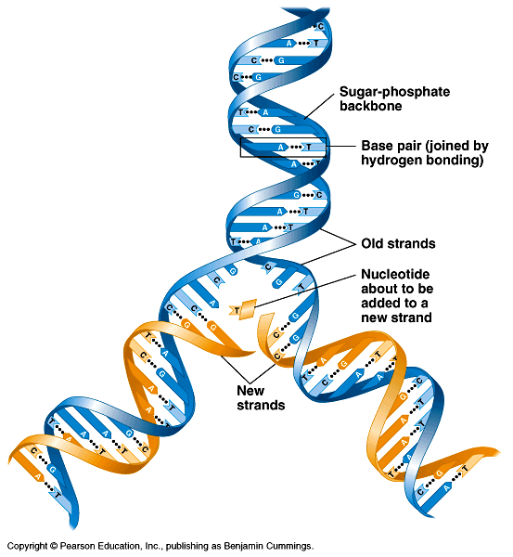
How is DNA copied?
Base pairing suggests that it will allow each side to serve as a template for a new strand

Slide 24
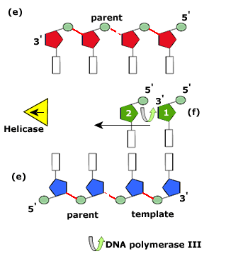
DNA Replication
Occurs in the 5’→3’
direction

Slide 25
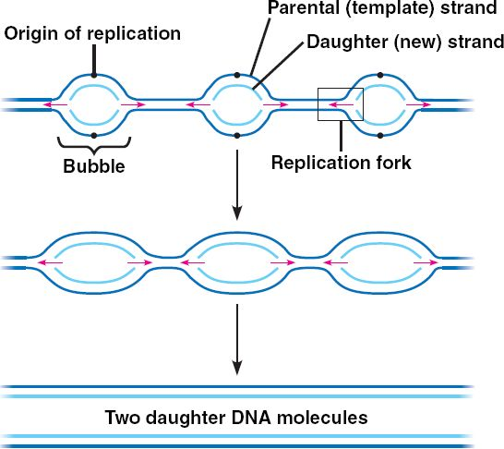
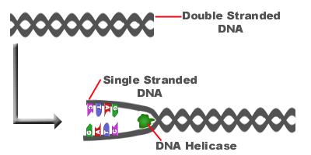
3 Steps of Replication
Step 1:
Helicase unzips double helix at numerous places along the chromosome (origins of replication)
By breaking hydrogen bonds connecting base pairs (How many hydrogen bonds are between G and C? A and T?)

Slide 26
Why are there multiple origins of origin?
Human chromosomes are replicated about 50 bp per second.
The average human chromosome contains bp
This process would take a month if there was only one point of origin.
Instead it takes only one hour

Slide 27
How is Prokaryotic DNA Replication Different?
DNA replication begins at a single, fixed location

Slide 28
3 Steps of Replication
Step 2
Free-floating nucleotides pair, one by one, with bases on the template
DNA polymerases bond the nucleotides together to form new strands that are complementary to each template strand

Slide 29
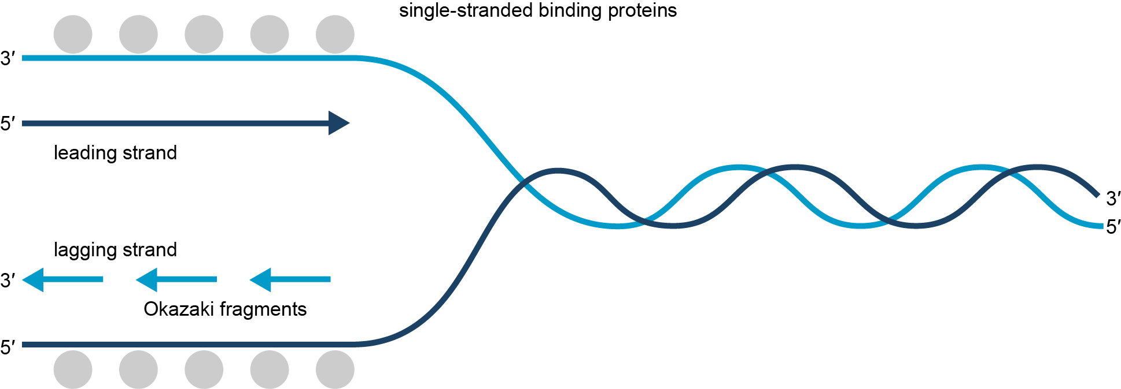
DNA replication occurs in a smooth, continuous way on the leading strand.
The lagging strand is assembled in short pieces called Okazaki fragments. The pieces are joined together by ligase.

Slide 30
3 Steps of DNA Replication
Step 3
Two identical molecules of DNA result
Each new molecule has one strand from the original molecule and one new strand
As a result, DNA replication is called semiconservative because one old strand is conserved, and one complementary new strand is made.

Slide 31
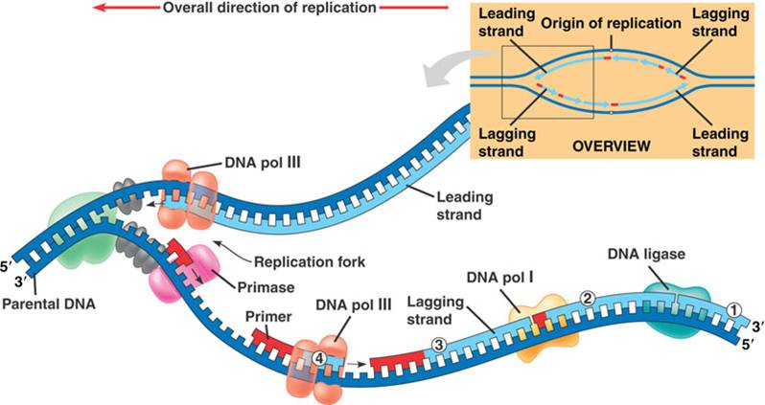

Slide 32
DNA Replication Concept Review
Describe what happens at a DNA replication fork during replication
Describe the role of helicases and DNA polymerases during DNA replication
State why DNA replication is a semi conservative process.
Compare the number of replication forks in a prokaryotic and eukaryotic DNA during replication
How are replication errors corrected?
Why are there two DNA polymerases at one replication fork?
Why are DNA repair enzymes important to an organisms survival?
Is a mutation that occurs during the formation of an egg cell or sperm cell more significant than a mutation that occurs in a body cell? Explain.

Slide 33
Protein Synthesis Objectives
Outline the flow of genetic information in cells from DNA to protein
Compare the structure of RNA with that of DNA
Summarize the process of transcription
Describe the importance of the genetic code
Compare the role of mRNA, rRNA and tRNA in translation
Identify the importance of learning about the human genome

Slide 34
Protein Synthesis Vocabulary
Ribonucleic acid RNA transcription
Translation protein synthesis
Ribose mRNA (messenger)
rRNA (ribosomal) tRNA (transfer)
RNA polymerase promoter
Termination signal genetic code
Codon anticodon
genome

Slide 35
Protein Synthesis Concept Review
Summarize the flow of genetic information.
List the four ways in which the structure of RNA differs from that of DNA
Sequence the main steps of transcription
What is the genetic code?
Compare the roles of the three different types of RNA during translation
Describe the significance of identifying the entire sequence of the human genome
How does the role of RNA polymerase in transcription differ from that of DNA polymerase in DNA replication?
What amino acids would translation for the mRNA with the sequence UAACAAGGAGCAUCC produce?
Discuss why it is important which of the two DNA strands ser ves as a template during translation.
How does the structure of tRNA relate to its function in translation?

