Slide 1
Chromosomes and Inheritance Objectives
Distinguish between the sex chromosomes and the autosomes.
Explain the role of Sex chromosomes in sex determination
Describe how an Autosomal recessive gene affects the inheritance of traits.
Describe how an Autosomal Dominant gene affects the inheritance of traits.
Describe how an X or Y linked gene affects the inheritance of traits.

Slide 2
Vocabulary
Sex chromosomes autosome
Sex linked trait autosomal dominant
Autosomal recessive X-linked dominant
X-linked recessive Y-linked
Genetic Disorder

Slide 3
Four most common patterns of genetic inheritance
Conditions due to a change in a single gene in families are therefore described as:
Autosomal recessive
Autosomal dominant
X-linked recessive
X-linked dominant

Slide 4
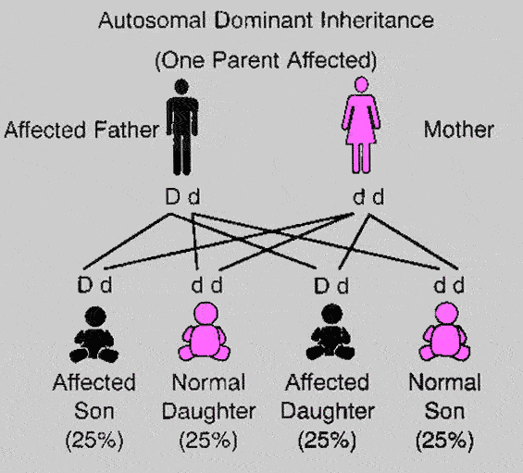

Slide 5
Common Autosomal Dominant Disorders
Neurofibromatosis type 1,
Achondroplasia,
Huntington disease
predisposition to breast, ovarian and bowel cancers
familial hypercholesterolaemia
Autosomal dominant polycystic kidney disease
Machado-Joseph Disease
Marfan syndrome
MODY diabetes
Otosclerosis

Slide 6
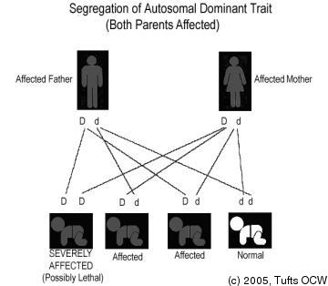

Slide 7
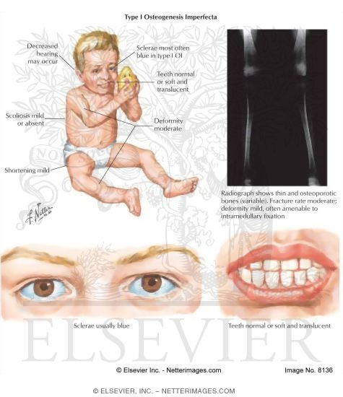
Osteogenesis Imperfecta Type I
Autosomal Dominant
Defect in collagen

Slide 8
Autosomal Recessive Disorders
Hundreds of conditions usually involving metabolic pathways
Most Common
Sickle cell disease – 1 in 625 (Black Africans)
Cystic fibrosis – 1 in 2500 (Caucasians)
Tay-Sacs disease – 1 in 3000 (Jews)
1 in 27 Ashkenazi Jews
Consanguinity (parents are related) Generally the risk is higher the more closely the parents are related The risk for the general population is roughly 2%
The risk for a consanguineous couple is roughly 4%

Slide 9
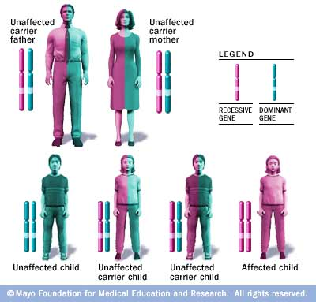

Slide 10
Expression of sex-linked genes
X and Y chromosomes have different genes
Males only have one copy of the X chromosome so even if they have a recessive gene on the X it will always be expressed

Slide 11
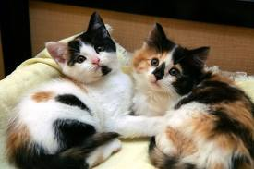
X Chromosome Inactivation
X chromosome inactivation
Female mammals have two copies of X
In each cell one X is randomly “turned off”
Called a Barr Body
Calico Cats

Slide 12
Worksheet
Calico Cats

Slide 13
X linked Recessive
Affected Females extremely rare
Almost 100% affected are male
Few hundred conditions X linked Recessive Conditions
Red-Green colour-blindness
Duchenne’s and Becker’s Muscular Dystrophies
Fragile X syndrome
Glucose-6-phosphate dehydrogenase deficiency
Haemophilia A and B
Hunter’s Syndrome

Slide 14
Quick Lab: Sex Linked Inheritance

Slide 15
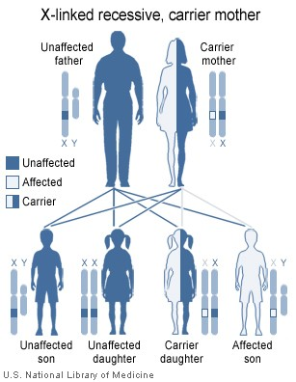
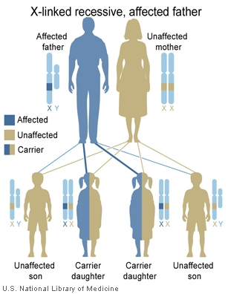
X Linked Recessive

Slide 16
X linked Dominant
Very Rare form of Inheritance
Vitamin D resistant Rickets

Slide 17
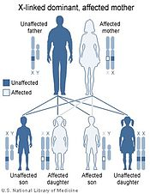
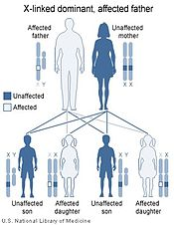
X linked Dominant

Slide 19
Human Genetics (2) Objectives
Analyze pedigrees to determine how genetic traits and genetic disorders are inherited
Summarize the different patterns of inheritance seen in genetic traits and genetic disorders.
Explain Polygenic inheritance
Explain the inheritance of ABO blood groups
Explain how geneticists can detect and treat genetic disorders

Slide 20
Human Genetics (2) Vocabulary
pedigree carrier polygenic
Multiple allele codominance
Incomplete dominance amniocentesis
Chorionic villi sampling genetic counseling
Gene therapy

Slide 21
Polygenic / Multifactorial Inheritance
There are many disorders for which there are many environmental and genetic factors at play that account for an individual’s overall risk of contracting the disease.
Genes that make you susceptible to a condition increase your risk of contracting the condition, but don’t necessarily mean you will get it.
The risk is particularly increased when:
You have a close relative with the disorder
Several members of the family have the disorder
The disease is known to be sex specific, and you are of that particular gender
A relative has had a particularly severe form of the disease

Slide 22
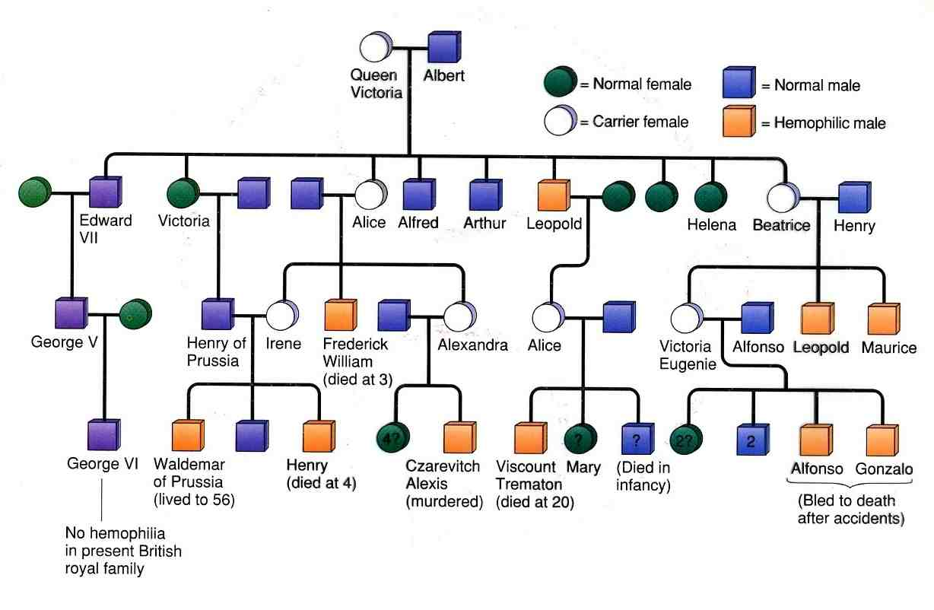
Pedigree
Male vs female
Affected vs unaffected
Horizontal lines indicate matings
Vertical lines indicate offspring
Arranged from left to right in order of birth

Slide 23
Polygenic / Multifactorial Inheritance
Some common conditions known to be multifactorial include:
Congenital Disorders:
Neural Tube Defects
+ environmental factors (folate)
Congenital Heart Disease
Cleft lip and palate
Pyloric Stenosis
Congenital dislocation of the hip
Talipes
Hypospadias
Other Conditions:
Atherosclerosis and CHD
+ environmental factors (obesity, smoking, sedentary lifestyle)
Diabetes mellitus
Asthma
Epilepsy
Hypertension

Slide 24
Y linked Dominant
Such conditions are extremely rare. They only affect males
an affected man will pass on the gene to all his sons.
The Y chromosome is typically only associated with spermatogenesis, and thus any conditions involving Y-linked inheritance will typically result in infertility.
Gene not passed on so disappears from population

Slide 25
Mitochondrial / Cytoplasmic Inheritance
Mitchondria have their own DNA. Each cell has 1,000 copies of mitochondrial DNA, but typically, only a proportion of the mitochondrial DNA is affected.
Mitochondrial DNA is only passed on through the mother – only the oocyte contain mitochondrial DNA and not the sperm.
Thus fathers with mitochondrial DNA disorders will not pass the defect onto their children.

Slide 26
Genetic Crosses Objectives
Differentiate between the genotype and phenotype of an organism.
Explain how probability is used to predict the results of genetic crosses.
Use a Punnet square to predict the results of monohybrid and dihybrid genetic crosses.
Explain how a test cross is used to show the phenotype of an individual who's phenotype expresses the dominant trait.
Differentiate a monohybrid cross from a dihybrid cross.

Slide 27
Genetic Crosses Vocabulary
Genotype phenotype homozygous
Heterozygous probability monohybrid cross
Punnet square genotypic ratio phenotypic ratio
Testcross dihybrid cross
complete dominance Incomplete dominance

Slide 28
Genotype and Phenotype
Genotype: the alleles that an organism inherits from its parents, it’s genetic makeup
Phenotype: the appearance of the organism.
Genotype: PP Pp or pp
Phenotype: purple flower or white flower

Slide 29
The same gene has many versions
Gene: a segment of DNA which produces a specific protein
Genome: all of an organisms genetic material.
Diploid organisms have two copies of each gene, one from each parent.
Allele alternative forms of a gene that occur at a specific locus (location on a chromosome)

Slide 30
Homozygous or Heterozygous
Homozygous: same two alleles for a trait
Homozygous dominant PP
Homozygous recessive pp
Heterozygous: two different alleles for a trait
Pp

Slide 31
Probability
The likelihood that a specific event will occur.
Probability = the number of times an event is expected to happen
number of times an event could happen

Slide 32
Calculating probability Lab:
materials: a paper sack containing 20 beads of three different colors
procedure: do not look in sack.
1. Pull one bead out and record the color. Return the bead to the sack and shake the bag to mix the colors.
2. Repeat step one until you have examined 20 beads.
3. determine the probability of getting a jelly bean of a specific color with a single draw. Do this for each of the three colors.
Compare your results with those of the rest of the class.
Analysis:
Does anyone have the same probabilities as you?
Are any probabilities very close to yours?
From these observations, determine how many beads of each color are in your sack.

Slide 33
Probability
Mendel’s experiments: Dominant trait was yellow seed color
The F2 generation had
6,022 yellow seed color
2,001 green seed color
Probability of yellow = 6,022/8,023 = 0.75 or 3:4
Probability of green = 2,001/8,023 = 0.25 or 1:4

Slide 34
Predicting Results: Punnet Square
Monohybrid Cross: a cross which is looking at only one trait.
Homozygous dominant x homozygous recessive
PPxpp
Genotype 100% Pp
Phenotype 100% purple
Homozygous dominant x heterozygous
PP x Pp
Genotype 50% PP 50% Pp
Phenotype 100% purple
Heterozygous x heterozygous
Pp x Pp
Genotype: 25% PP 50% Pp 25% pp
Phenotype: 75% purple and 25% white
When expressed as a ratio, the results would be:
1 PP : 2Pp : 1 pp for the genotype
3 purple : 1 white for the phenotype
Show Punnet Square for each of these crosses

Slide 35
Complete Dominance
All of Mendel's traits showed complete dominance.
You cannot distinguish between homozygous dominant and heterozygous individuals by their phenotype when there is complete dominance
Example PP and Pp both have purple flowers.
You would have to do a testcross with a homozygous recessive individual to determine the genotype

Slide 36
Testcross
A test cross can be used to determine the genotype of an individual which expresses the dominant trait.
You cross that individual to a homozygous recessive individual.
If the offspring all have the dominant trait, the tested individual was homozygous dominant
If the offspring have the recessive trait, then the tested individual was heterozygous for the trait.
Show a Punnet square cross for each possibility

Slide 37
Incomplete Dominance
Incomplete Dominance: the heterozygous offspring have a phenotype intermediate between the phenotype shown for the homozygous offspring
Example pink flowers in the four-oclock-plant
RR (red) x rr(white) = Rr (pink)
What would be the result of crossing two pink flowering plants?

Slide 38
Codominance
Codominance: both alleles are expressed in a heterozygous offspring
Neither allele is dominant or recessive
The alleles do not blend in phenotypes as they do in incomplete dominance
Roan colored animals: coat has both white and red hairs.
Blood type: Both alleles M and N refer to molecules on the surface of Red blood cells.
Genotype L^{M} L^{N} will have both M and N molecules on the surface of the red blood cells.
Show Punnet Square for each of these Crosses

Slide 39
Multiple Alleles
Blood type Controlled by 3 different alleles
Allele I^{A} : causes A antigen (protein on the cell surface on red blood cells) Codominant to B
Allele I^{B}: causes B antigens on the RBC Codominant to A
Allele I^{O}: recessive gene which does not result in the production of a surface antigen on RBC
Phenotype AB Genotype?
Phenotype A Genotype?
Phenotype B Genotype?
Phenotype O Genotype?

Slide 40
Blood Type Worksheet

Slide 41
Polygenic Traits
Traits produced by two or more genes
Most traits are polygenic
Human Skin Color: four genes
Human Eye Color: Three genes identified so far… Brown (most dominant) Green (recessive when paired with brown, dominant when paired with Blue) and Blue recessive
Fur Color: 2 genes affect color, one gene affects the shading of that color, one gene determines the presence of spots
gene that dominant over all the gene and causes Albinism. This gene controls the production of melanin. You must have two recessive versions of this gene to produce no melanin and become an albino.

Slide 42
Human Height
The combined size of all of the body parts from head to foot determines the height of an individual. There is an additive effect.
The sizes of all of these body parts are, in turn, determined by numerous genes.

Slide 43
Environment and Genotypes
Genes and the environment interact to determine the expression of traits.
Sex of Sea Turtles
Identical Twins
Differences in environment at early ages can have long lasting effects.

Slide 44
Dihybrid cross
Cross which tracks two characteristics.
For example track seed texture Round R and wrinkled r
Seed color Yellow Y and green y
Homozygous recessive x homozygous dominant
Heterozygous x Heterozygous
Show Punnet Squares for each Cross

Slide 45
Genetic Crosses Concept Review
Explain why a phenotype may not always indicate genotype
Identify the equation used to determine probability
Explain how you might go about determining the genotype of a purple-flowering plant
Illustrate in the form of a Punnet square the results of crossing a pink flowering plant with a white flowering plant
Explain the difference between a monohybrid cross and a dihybrid cross and give an example of each.
The offspring of two short tailed cats have a 25% chance of having a long tail, a 50% chance of having a short tail and a 25% chance of having no tail. Using this information what can you hypothesize about the way in which tail length is inherited?
If you crossed two purple-flowering pea plants and all the F1 offspring were purple flowering, what could you say about the genotypes of the parents? If some of the F1 offspring were white-flowering, what could you say about the genotypes of the parents?

Slide 46
Concept Review Continued…
The traits are for mouse genes. R=Running (this is "normal" and dominant) r= waltzing (a rare condition in mice, recessive) also we are using one of the coat color genes: B=Black (dominant) b=brown (recessive)
Use the notes for directions and example for how to do the dihybrid cross punnett square. Make a punnett square for each problem and write out the phenotype ratios.
1. Heterozygous running, heterozygous black mouse crossed with a homozygous running, homozygous black mouse.
2. RRBB x Rrbb
3. A Waltzing brown mouse with another waltzing brown mouse.
4. A homozygous running, heterozygous black mouse with a waltzing brown mouse.
5. A heterozygous running, brown mouse with a heterozygous running, homozygous black mouse.
6. Cross two mice that are heterozygous for both traits. (RrBb x RrBb)

Slide 47
Help Sites:
Link to some more Practice Punnet Square problems with solutions.
More Practice Problems

