Slide 1
Build Your Own Biosphere

Slide 2
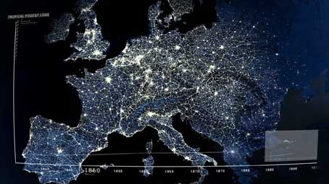
Welcome to the
Anthropocene

Slide 3
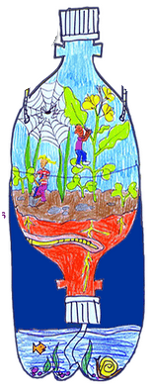
Driving Question
What combination of plants, animals, and inorganic resources is required to successfully create an enclosed, sustainable, artificial biosphere?
Project Challenge

Slide 4
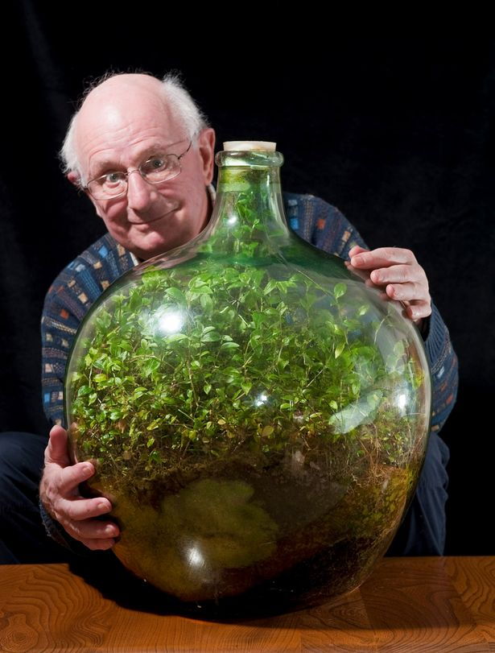
Motivation

Slide 5
Objectives
SC.912.E.7.1: Describe the water and carbon cycle
SC.912.L.17.9: Construct food web and identify producers, consumers and decomposers. Explain the transfer of energy in an ecosystem
SC.912.L.17.20: Examine how human lifestyles has affected the sustainability of ecosystems
SC.912.L.18.7: Identify the reactants, products, and functions of photosynthesis
SC.912.L.18.9: Explain how photosynthesis and cellular respiration are related
SC.912.N.1.1: Conduct a scientific investigation. Make observations during experiments. Generate inferences using evidence from observations

Slide 6
Project Timeline
Monday | Tuesday | Wednesday | Thursday | Friday
Benchmark | Investigative | Investigative | Benchmark | Investigative
Project Launch Human Activity | Biomes | Build Your Terrarium | Water Cycle | Water Cycle
Monday | Tuesday | Wednesday | Thursday | Friday
Benchmark 2-Day Lesson | Benchmark 2-Day Lesson | Investigative | Benchmark | Benchmark
Photosynthesis | Photosynthesis Carbon Cycle | Carbon Cycle | Food Webs | Food Webs
Monday | Tuesday | Wednesday | Thursday | Friday
Investigative | Field Trip | Investigative
Food Webs | Butterfly Rainforest | Final Observations | Poster Preparation | Poster Presentation

Slide 7
Formative Assessment
Total of 14 formative assessments
RERUN
Recall: Summarize how you have built your terrarium
Explain: Explain any modifications you have made since initially creating it
Results: Describe your most recent observation of your terrarium
Uncertainties: Describe what you are still unsure about
New: Write at least two new things that you have learned since initially building your terrarium
Think-Pair-Share: reading and reflecting on article and sharing to class
Chain Note: A piece of paper is passed around the class with the question, “What concepts must you think about when building a sustainable ecosystem?”

Slide 8
Concept Cartoon

Slide 9
First Word-Last Word

Slide 10
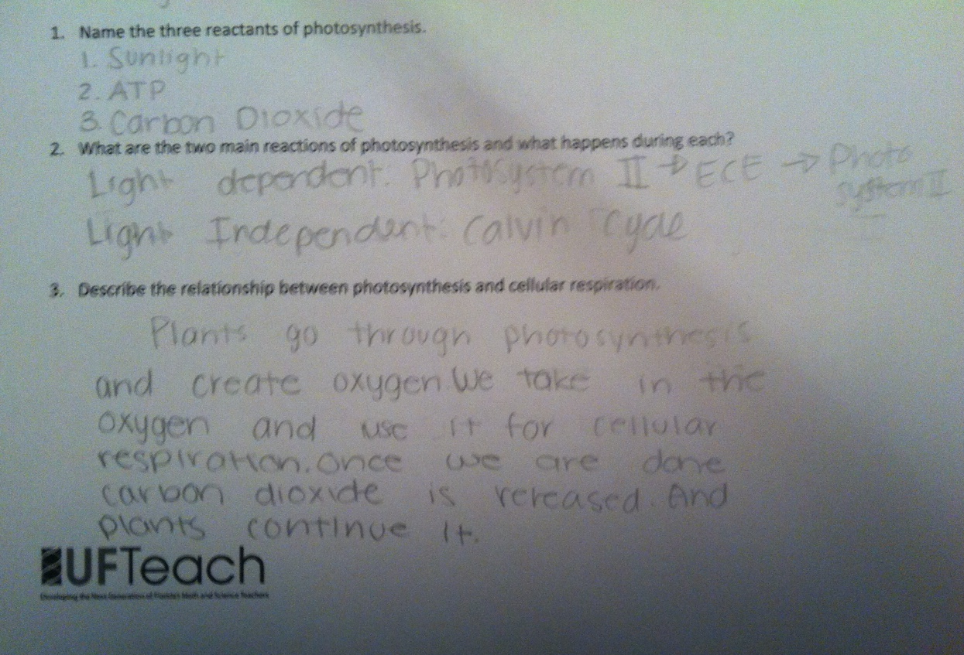
Three-Two-One

Slide 11
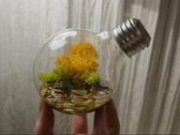
Summative Assessment
Unit Project
Terrarium
A minimum of 2 species
Biome
Log Book
Construction
Concepts
Poster: to be presented to peers and parents
Organization of final recommendations for SafeHaven

Slide 12
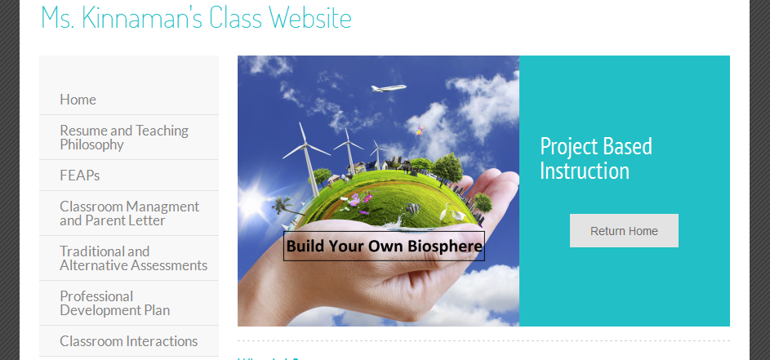

Slide 13
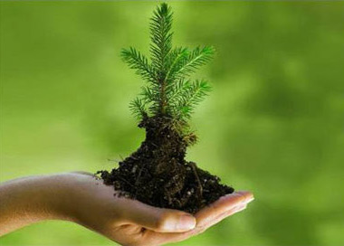
Lessons Learned
Importance of the engagement
Relationship between benchmarks and project
Making the unit cohesive
Importance of feedback and collaboration
Preparation

Slide 14
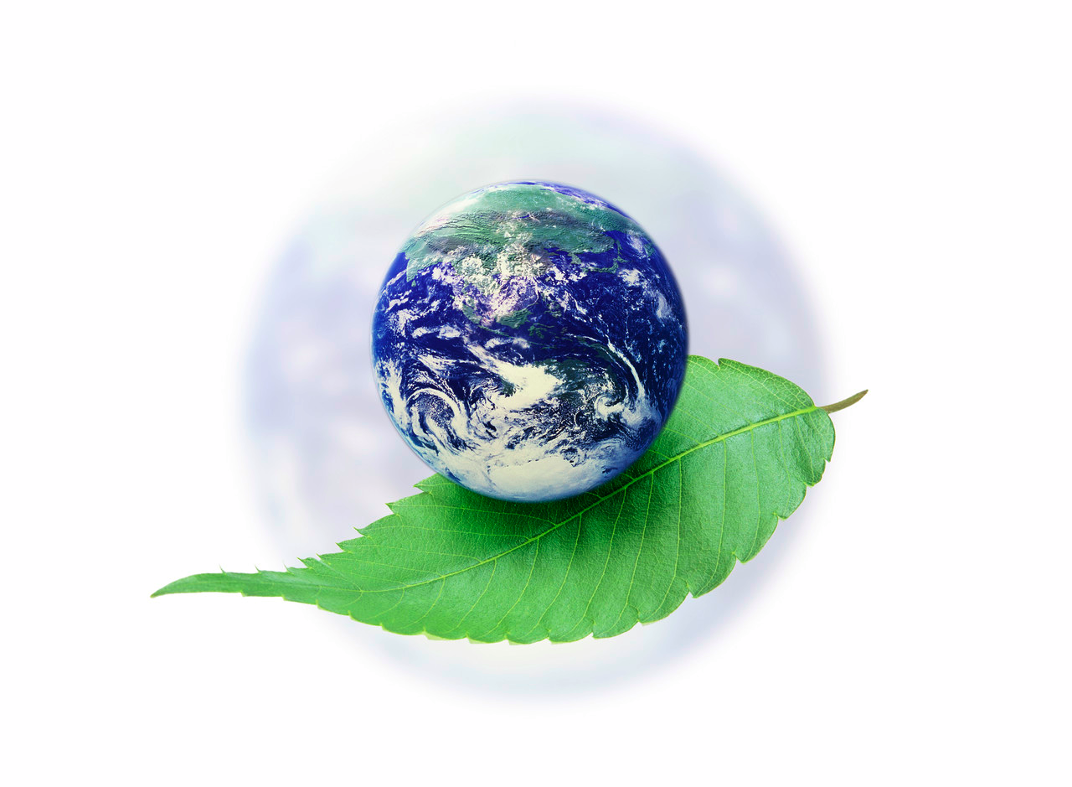
QUESTIONS???

